Slide 1
Python basics
Presenter：Huizhong Wang
224045005@link.cuhk.edu.cn
Notes:
Today's tutorial covers the basics of Python.
You might know that Java is great for building web applications,
but Python is the top choice for AI and machine learning.
If you are interested in AI research or projects, Python should be your first language.
This crash course will give you a brief profile of it.

Slide 2

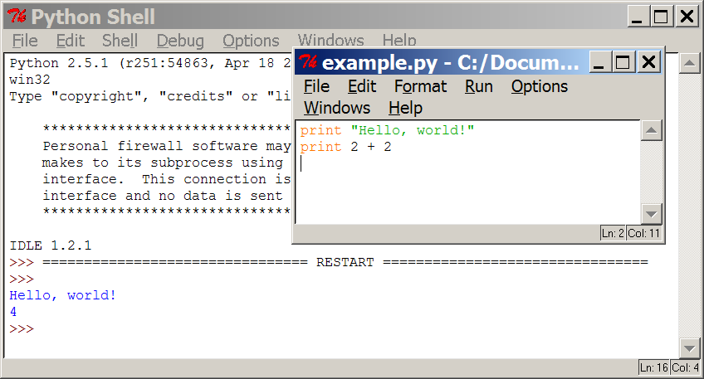
Programming basics
code or source code: The sequence of instructions in a program.
syntax: The set of legal structures and commands that can be used in a particular programming language.
output: The messages printed to the user by a program.
console: The text box onto which output is printed.
  Some source code editors pop up the console as an external window,
and others contain their own console window.
Notes:
Let's start with some programming fundamentals.
The sequence of instructions you write is called the source code.
The rules and structures that define correct programs in a language are its syntax. Keywords like if, else, for, and while are all part of Python's syntax.
The information a program displays is called its output. For example, printing "Hello, world!" produces that text as output.
The console is the text environment (often a window) where this output is displayed.

Slide 3




Compiling and interpreting
Many languages require you to compile (translate) your program into a form that the machine understands.
compile execute
source code
Hello.java
byte code
Hello.class
output
Python is instead directly interpreted into machine instructions.
interpret
source code
Hello.py
output
Notes:
When writing in languages like Java, C, or C++, you must first compile your program before executing it.
Compilation is a separate step that translates the entire source code into machine-readable instructions (a sequence of 0s and 1s).
Python, in contrast, is typically an interpreted language. It can skip this explicit compilation step.
When you run a Python program, an interpreter translates and executes the code line-by-line in real-time, dynamically converting it into machine instructions.

Slide 4
The Python Interpreter
Python is an interpreted
language
The interpreter provides an interactive environment to play with the language
Results of expressions are printed on the screen
>>> 3 + 7
10
>>> 3 < 15
True
>>> 'print me'
'print me'
>>> print('print me') print me
>>>
Notes:
As a result, Python is an interpreted language, which allows you to explore it in an interactive environment.
As shown on the right, when you start a Python console, you can communicate with it directly.
For instance, if you want to calculate something, just type the expression (e.g., 3 + 7) and press Enter. The answer, 10, will be displayed instantly.
This environment also supports complex tasks, like writing and testing functions, providing immediate feedback.

Slide 5
Expressions
expression: A data value or set of operations to compute a value.
Examples:
1 + 4 * 3
42
Arithmetic operators we will use:
+ - * / //
%
**
addition, subtraction/negation, multiplication, division modulus, a.k.a. remainder
exponentiation
precedence: Order in which operations are computed.
  ** has a higher precedence than * / // % + -
  * / // % have a higher precedence than + -
1 + 3 * 4 is 13
  Parentheses can be used to force a certain order of evaluation.
(1 + 3) * 4 is 16
Notes:
Now that we've seen the Python environment, let's dive into some basic syntax.
We'll start with expressions.
An expression is any combination of values, variables, and operators that computes and returns a value.
For example, 1 + 4 * 3 is an expression, and even a single value like 42 is considered an expression.
You can build expressions using arithmetic operators like:
Addition (+)
Subtraction (-)
Multiplication (*)
Division (/)
Exponentiation (**)
These operators follow standard precedence rules (just as in mathematics), which determine the order of operations in an expression.

Slide 6
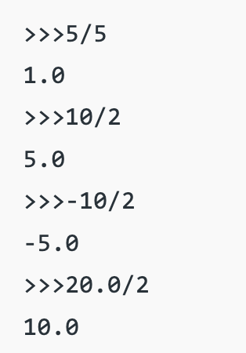
Float division
When we divide numbers with / , the quotient is always a float number
Notes:
Division requires a bit of attention.
In Python, the standard division operator (/) always yields a floating-point result,
regardless of whether the inputs are integers or floats.

Slide 7
Integer division (floor)
When we divide integers with // , the quotient is also an integer.
If any of the numbers is float, it returns output in float.
Examples:
  35 // 5 is 7
  84 // 10 is 8
  156 // 100 is 1
  35 // 5.0 is 7.0
  84 // 10.0 is 8.0
3 |  | 52
4 ) 14 | 27 | ) 1425
12 |  | 135
2 |  | 75
 |  | 54
 |  | 21
The % operator computes the remainder from an integer division.
3
4 ) 14
12
2
43
5 ) 218
20
18
15
3
Notes:
For integer division that discards the remainder, Python provides the floor division operator (//).
The result's type depends on the operands: if both are integers, it returns a rounded-down integer; if either is a float, it returns a rounded-down float.
The modulo operator (%) computes the remainder of an integer division. For example:
14 % 4 evaluates to 2
218 % 5 evaluates to 3

Slide 8
Math commands
Python has useful commands (or called functions) for performing calculations.
Constant | Description
e | 2.7182818...
pi | 3.1415926...
Command name | Description
abs(value) | absolute value
ceil(value) | rounds up
cos(value) | cosine, in radians
floor(value) | rounds down
log(value) | logarithm, base e
log10(value) | logarithm, base 10
max(value1, value2) | larger of two values
min(value1, value2) | smaller of two values
round(value) | nearest whole number
sin(value) | sine, in radians
sqrt(value) | square root
To use many of these commands, you must write the following at the top of your Python program:
from math import *
8
Notes:
Python also provides a wide range of mathematical functions through its math module,
including operations for absolute value, sine and cosine, and more.
To access these functions, you need to import the module at the beginning of your program using:
from math import *

Slide 9
Numbers: Floating Point
int(x) converts x to an integer
float(x) converts x to a floating point
can use type() to see the type of a variable
>>> 1.23232
1.2323200000000001
>>> print(1.23232)
1.23232
>>> 1.3E7
13000000.0
>>>int(2.0)
2
>>> float(2)
2.0
>>> type(2.0)
float
Notes:
Python provides built-in functions for explicit type conversion.
You can use int(x) to convert x to an integer,
float(x) to convert it to a floating-point number,
and type(x) to inspect the data type of a variable.

Slide 10
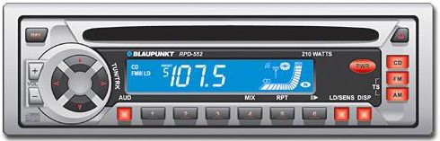
Variables
variable: A named piece of memory that can store a value.
  Usage:
    Compute an expression's result,
    store that result into a variable,
    and use that variable later in the program.
assignment statement: Stores a value into a variable.
  Syntax:
name = value
Examples:
x = 5
gpa = 3.14
x
5
gpa
3.14
A variable that has been given a value can be used in expressions.
x + 4 is 9
Notes:
In programming, you often compute a result that needs to be stored for later use.
This is where variables come in.
A variable is a named piece of memory that stores a value. It allows you to compute an expression's result, save it, and reuse it later.
To assign a value to a variable in Python, you use the syntax: name = value.
For example:
Writing x = 5 stores the integer 5 in a variable named x.
Writing gpa = 3.14 stores the float 3.14 in a variable named gpa.
Once stored, you can use these variable names in subsequent expressions.

Slide 11
Example
>>> x = 7
>>> x 7
>>> x+7
14
>>> x = 'hello'
>>> x
'hello'
>>>
Notes:
In Python, you do not need to declare a variable's type.
The type is automatically determined by the value you assign to it.
So you can assign an integer to a variable x and later reassign a string to that same variable.

Slide 12
print
print() : Produces text output on the console.
Syntax:
  print("Message")
  print(Expression)
Prints the given text message or expression value on the console, and
moves the cursor down to the next line.
print(Item1, Item2, ..., ItemN)
  Prints several messages and/or expressions on the same line.
Examples:
print("Hello, world!")
age = 45
print("You have", 65 - age, "years until retirement")
Output:
Hello, world!
You have 20 years until retirement
Notes:
To build interactive programs, handling input and output is essential.
In Python, the print function manages output operations. It can display both simple messages and evaluated expressions.
A particularly convenient feature is outputting multiple values—simply separate them with commas,
and print will automatically format them with spaces.
Leveraging Python's dynamic typing, you can directly reference variables in output statements without any type declarations.
For example, you can print a simple message like "Hello, World!" or output messages that include expressions.

Slide 13
input
input : Reads a string from user input.
  You can assign (store) the result of input into a variable.
  Example:
age = int(input("How old are you? "))
print("Your age is", age)
print("You have", 65 - age, "years until retirement")
Output:
How old are you? 53
Your age is 53
You have 12 years until retirement
Notes:
In Python, the input() function handles user input.
It reads a line from the console and returns it as a string.
You can assign this returned value directly to a variable.
Additionally, the input() function can accept a prompt string as an argument, which is displayed to the user before waiting for their input.

Slide 14
Input: Example
print("What's your name?")
name = input("> ")
print("What year were you born?")
birthyear = int(input("> "))
print("Hi ", name, "!", "You are ", 2022 - birthyear)
% python3 input.py What's your name?
> Michael
What year were you born?
>1980
Hi Michael! You are 42
Notes:
This is a program that uses the input and print functions to achieve simple user interaction.
In this example, you can notice how python is convenient.

Slide 15
Q&A

